Slide 1

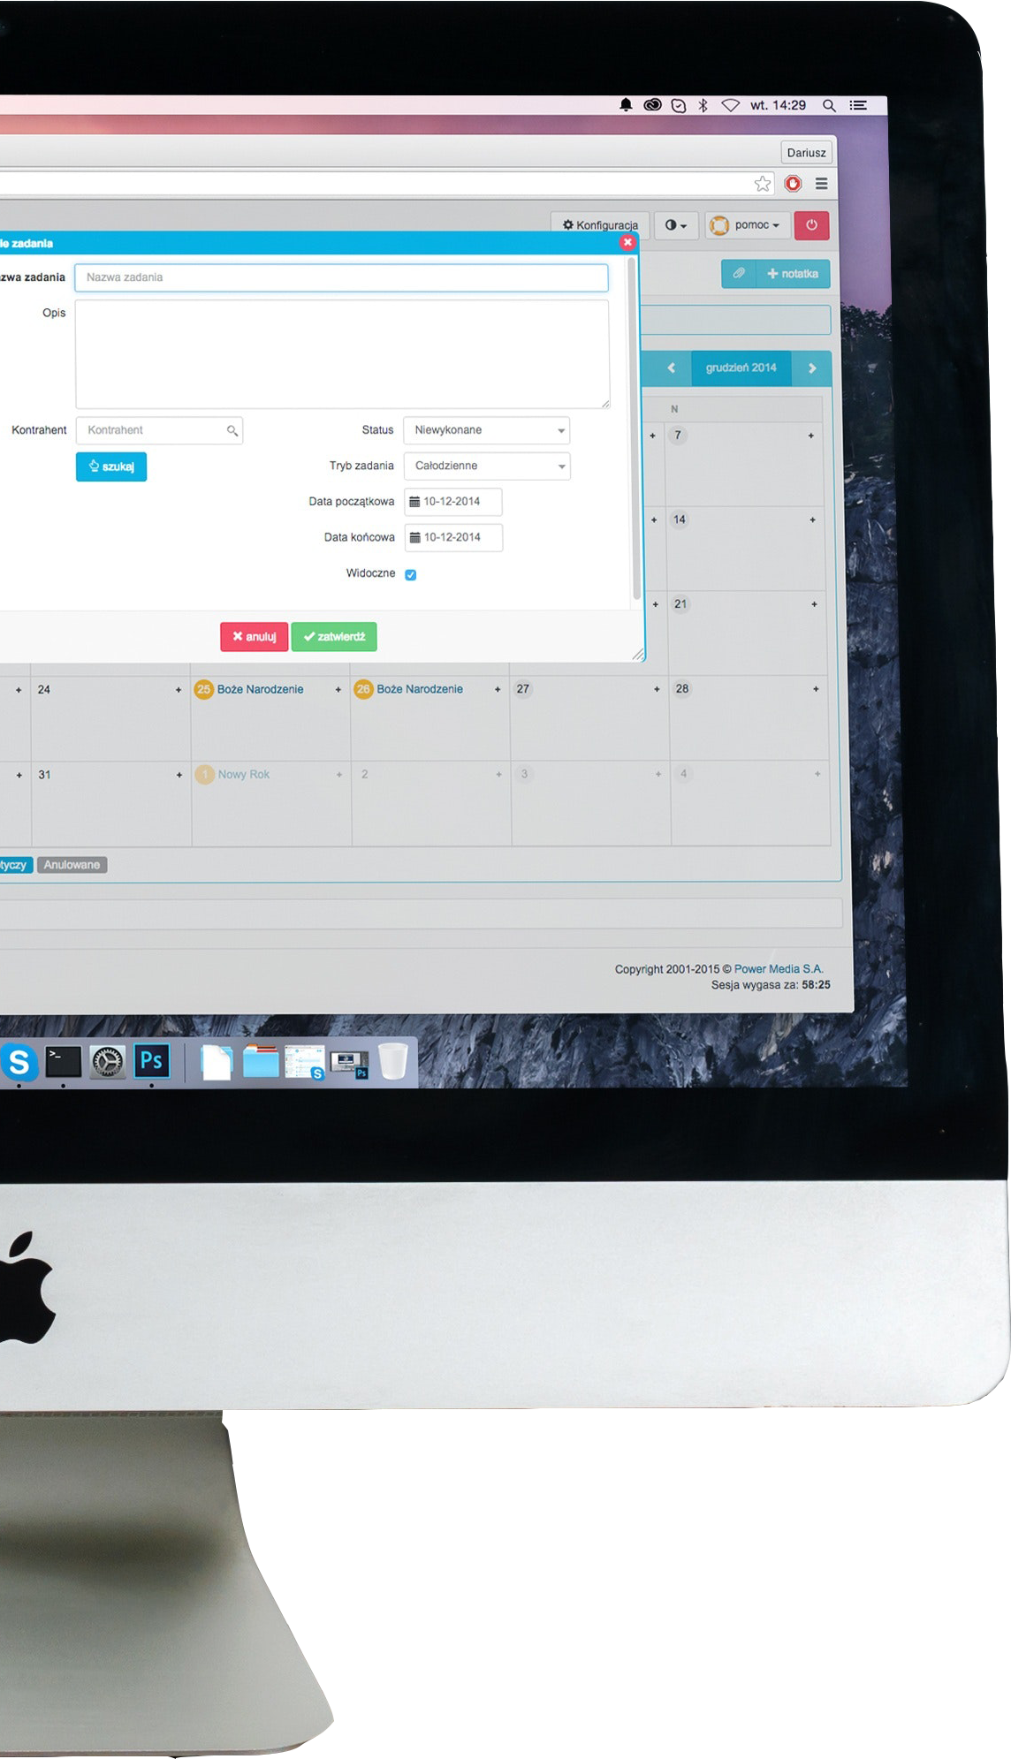

Introduction to Internet Software Architecture
4CS017
Facilitators:
Deepson Shrestha (Module Leader)
Bishal Khadka
Aagya Sharma
Bibek Pancha
Pradeep Mani Dixit
Karan Shrestha
Jeshmi Rajak (GTA)

Slide 2


This Module’s agenda…
Understand Internet and cloud-based software architecture and related technologies and tools and techniques
Design a suitable architecture depending on a set of requirements and constraints.
Implement a simple distributed application using an appropriate architecture and suitable technologies.

Slide 3
Attendance for every class is very important.
Failure to attend class without prior valid reason will result in the holding of your assessment.
Programming is not through memorizing it. It is learned through constant practice, exercises and research.
We want to provide you the best possible environment to help you grow, practice and improve effectively.

Slide 4
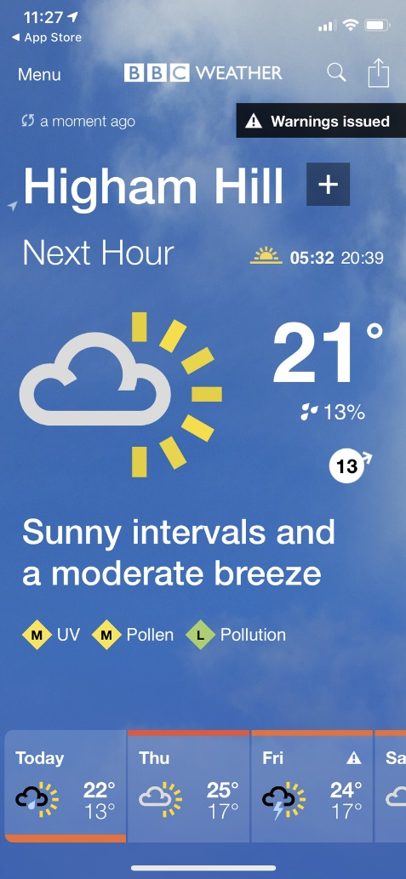
Assessment
As part of a portfolio you will be designing and improving a Weather Forecast App:
Version 1: simple architecture (JavaScript + Weather API)
Version 2: architecture improved with server-side caching (PHP + MySQL)
Version 3: architecture improved with browser caching.

Slide 5
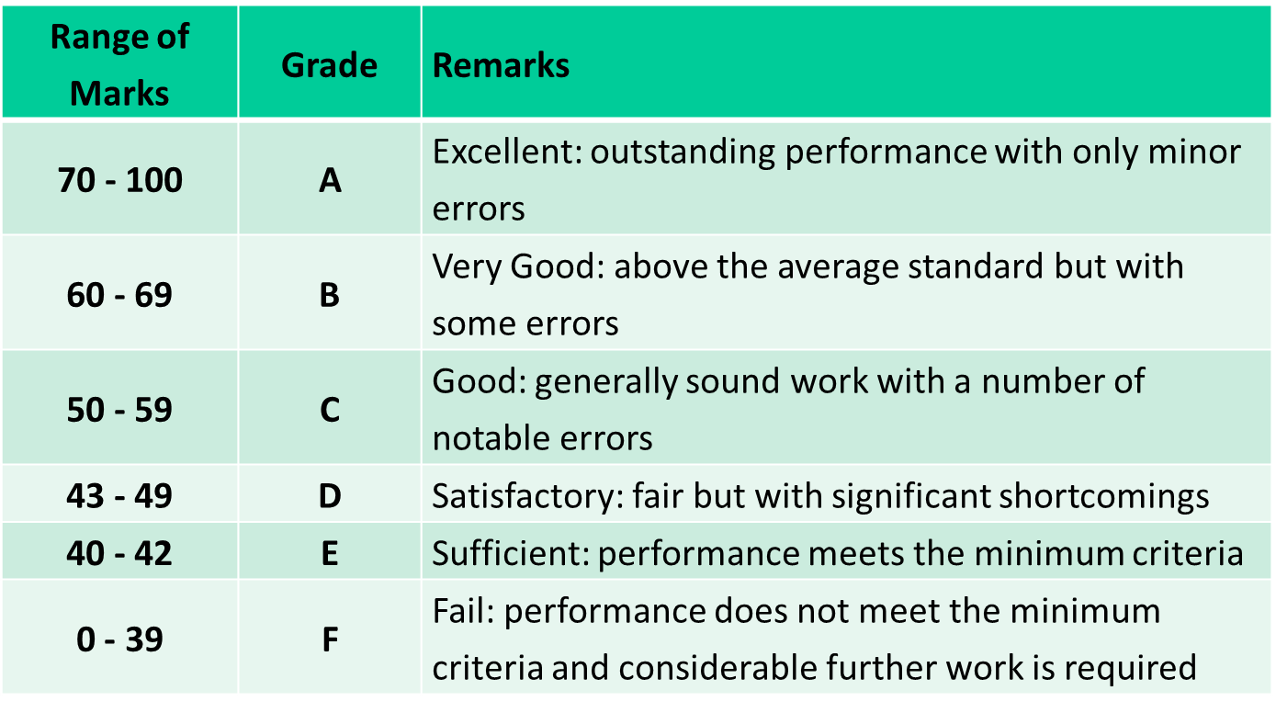
Module Grading standards in the U.K

Slide 6
More details about assessment will be provided during your workshop classes.

Slide 7

Any Questions

Slide 8
Introduction to Internet Software Architecture
Lecture Week 1
Internet and Web Technologies

Slide 9

What is Internet?
1. Internet
1.1. Internet Protocol
1.2. IP Address
1.3. Internet Software Architecture
2. Web Technologies
2.1. Anatomy of Web
2.2. Server-side
2.3. Client-side
2.4. Anatomy of Webpage
2.4.1. HTML
2.4.2. CSS
2.4.3. JavaScript
3. Overview on HTTP
3.1. HTTPS
3.2. OSI Model
4. Information Architecture
5. Service-Oriented Architecture
6.Web Performance
6.1. How to increase Web Performance
7.Learn more

Slide 10
Internet Protocol (IP)
1. Internet
1.1. Internet Protocol
1.2. IP Address
1.3. Internet Software Architecture
2. Web Technologies
2.1. Anatomy of Web
2.2. Server-side
2.3. Client-side
2.4. Anatomy of Webpage
2.4.1. HTML
2.4.2. CSS
2.4.3. JavaScript
3. Overview on HTTP
3.1. HTTPS
3.2. OSI Model
4. Information Architecture
5. Service-Oriented Architecture
6.Web Performance
6.1. How to increase Web Performance
7.Learn more
IP stands for "Internet Protocol," which is the set of rules governing the format of data sent via the internet or local network.

Slide 11
IP Address
1. Internet
1.1. Internet Protocol
1.2. IP Address
1.3. Internet Software Architecture
2. Web Technologies
2.1. Anatomy of Web
2.2. Server-side
2.3. Client-side
2.4. Anatomy of Webpage
2.4.1. HTML
2.4.2. CSS
2.4.3. JavaScript
3. Overview on HTTP
3.1. HTTPS
3.2. OSI Model
4. Information Architecture
5. Service-Oriented Architecture
6.Web Performance
6.1. How to increase Web Performance
7.Learn more
An Internet Protocol address (IP address) is a numerical label assigned to each device connected to a computer network that uses the Internet Protocol for communication. An IP address serves two main functions: host or network interface identification and location addressing.

Slide 12
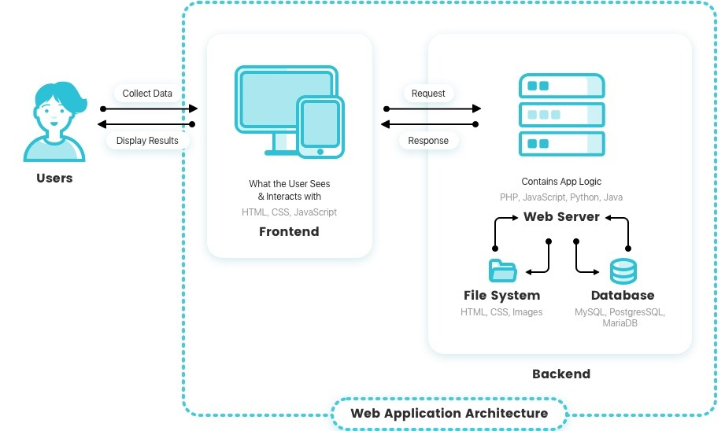
Internet Software Architecture
1. Internet
1.1. Internet Protocol
1.2. IP Address
1.3. Internet Software Architecture
2. Web Technologies
2.1. Anatomy of Web
2.2. Server-side
2.3. Client-side
2.4. Anatomy of Webpage
2.4.1. HTML
2.4.2. CSS
2.4.3. JavaScript
3. Overview on HTTP
3.1. HTTPS
3.2. OSI Model
4. Information Architecture
5. Service-Oriented Architecture
6.Web Performance
6.1. How to increase Web Performance
7.Learn more
Defines the interaction between application, middleware systems and databases to ensure multiple applications can work together.
12

Slide 13
Web Technologies
1. Internet
1.1. Internet Protocol
1.2. IP Address
1.3. Internet Software Architecture
2. Web Technologies
2.1. Anatomy of Web
2.2. Server-side
2.3. Client-side
2.4. Anatomy of Webpage
2.4.1. HTML
2.4.2. CSS
2.4.3. JavaScript
3. Overview on HTTP
3.1. HTTPS
3.2. OSI Model
4. Information Architecture
5. Service-Oriented Architecture
6.Web Performance
6.1. How to increase Web Performance
7.Learn more

Slide 14
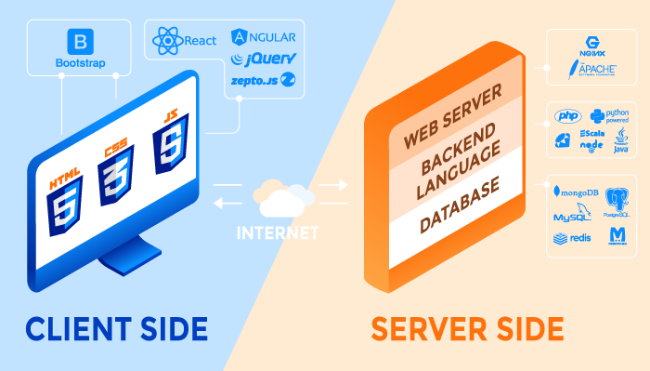
Anatomy of Web
1. Internet
1.1. Internet Protocol
1.2. IP Address
1.3. Internet Software Architecture
2. Web Technologies
2.1. Anatomy of Web
2.2. Server-side
2.3. Client-side
2.4. Anatomy of Webpage
2.4.1. HTML
2.4.2. CSS
2.4.3. JavaScript
3. Overview on HTTP
3.1. HTTPS
3.2. OSI Model
4. Information Architecture
5. Service-Oriented Architecture
6.Web Performance
6.1. How to increase Web Performance
7.Learn more
14

Slide 15
Server-side or Backend Scripting
1. Internet
1.1. Internet Protocol
1.2. IP Address
1.3. Internet Software Architecture
2. Web Technologies
2.1. Anatomy of Web
2.2. Server-side
2.3. Client-side
2.4. Anatomy of Webpage
2.4.1. HTML
2.4.2. CSS
2.4.3. JavaScript
3. Overview on HTTP
3.1. HTTPS
3.2. OSI Model
4. Information Architecture
5. Service-Oriented Architecture
6.Web Performance
6.1. How to increase Web Performance
7.Learn more
A server is basically a computer in a server station.
It serves as a storage facility for your application and your database.
All your server-side scripting or your backend scripting is run in the server itself.
A “server-side scripting” is a technique or a language that is used to write your application and which is processed on the server itself.
The script executes before your HTML is loaded, not after.
Some examples of Backend Scripting languages are Java, Python, PHP, JavaScript, etc.

Slide 16
Client-side or Front End Scripting
1. Internet
1.1. Internet Protocol
1.2. IP Address
1.3. Internet Software Architecture
2. Web Technologies
2.1. Anatomy of Web
2.2. Server-side
2.3. Client-side
2.4. Anatomy of Webpage
2.4.1. HTML
2.4.2. CSS
2.4.3. JavaScript
3. Overview on HTTP
3.1. HTTPS
3.2. OSI Model
4. Information Architecture
5. Service-Oriented Architecture
6.Web Performance
6.1. How to increase Web Performance
7.Learn more
Client-side is basically from where you access the server.
A user uses client-side software such as Google Chrome to send and receive requests to and from the server.
The request received can be in a form of HTML, content or JSON APIs.
Client-side or front end scripting is a technique or languages that runs in the client-side software.
Some of the examples of client side languages are HTML and JavaScript.

Slide 17
Anatomy of a Webpage
1. Internet
1.1. Internet Protocol
1.2. IP Address
1.3. Internet Software Architecture
2. Web Technologies
2.1. Anatomy of Web
2.2. Server-side
2.3. Client-side
2.4. Anatomy of Webpage
2.4.1. HTML
2.4.2. CSS
2.4.3. JavaScript
3. Overview on HTTP
3.1. HTTPS
3.2. OSI Model
4. Information Architecture
5. Service-Oriented Architecture
6.Web Performance
6.1. How to increase Web Performance
7.Learn more
Slider
Main Content | Sidebar
Copyright
LOGO
Navigation Menu Bar
Header
Body
Footer

Slide 18
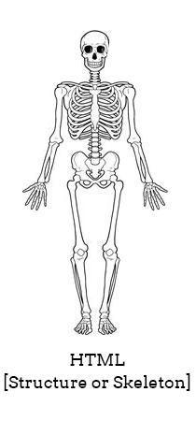
What are Web Pages made of?
1. Internet
1.1. Internet Protocol
1.2. IP Address
1.3. Internet Software Architecture
2. Web Technologies
2.1. Anatomy of Web
2.2. Server-side
2.3. Client-side
2.4. Anatomy of Webpage
2.4.1. HTML
2.4.2. CSS
2.4.3. JavaScript
3. Overview on HTTP
3.1. HTTPS
3.2. OSI Model
4. Information Architecture
5. Service-Oriented Architecture
6.Web Performance
6.1. How to increase Web Performance
7.Learn more
HTML (Hyper Text Markup Language)
This allows you to write structural/markup codes for your webpage.
Creates a structure/skeleton for your webpage.
Without styling and interaction, HTML does not look useful.
HTML5 is a semantic markup language.
The language has tags, elements and attributes.

Slide 19
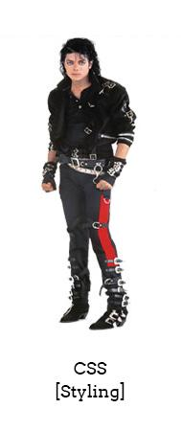
What are Web Pages made of?
1. Internet
1.1. Internet Protocol
1.2. IP Address
1.3. Internet Software Architecture
2. Web Technologies
2.1. Anatomy of Web
2.2. Server-side
2.3. Client-side
2.4. Anatomy of Webpage
2.4.1. HTML
2.4.2. CSS
2.4.3. JavaScript
3. Overview on HTTP
3.1. HTTPS
3.2. OSI Model
4. Information Architecture
5. Service-Oriented Architecture
6.Web Performance
6.1. How to increase Web Performance
7.Learn more
CSS (Cascading Style Sheets)
This allows you to add styling to your HTML structure.
The CSS has selectors, properties and values.
Styling is done by targeting the given selector.
CSS Selectors can either be element, classes, ids or attributes.
CSS is used give layouts to your structure using the Box Model.

Slide 20
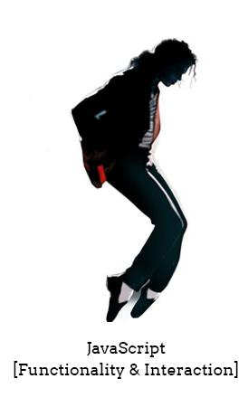
What are Web Pages made of?
1. Internet
1.1. Internet Protocol
1.2. IP Address
1.3. Internet Software Architecture
2. Web Technologies
2.1. Anatomy of Web
2.2. Server-side
2.3. Client-side
2.4. Anatomy of Webpage
2.4.1. HTML
2.4.2. CSS
2.4.3. JavaScript
3. Overview on HTTP
3.1. HTTPS
3.2. OSI Model
4. Information Architecture
5. Service-Oriented Architecture
6.Web Performance
6.1. How to increase Web Performance
7.Learn more
JavaScript
This allows you to add some functionality and interaction to your web application.
JavaScript is a scripting language, which means you don’t have to render or compile it like Java.
It is a client side scripting language. It runs on browser itself.
JavaScript itself is based on objects and prototypes.

Slide 21
Any Questions

Slide 22

be back in 10 minutes…

Slide 23
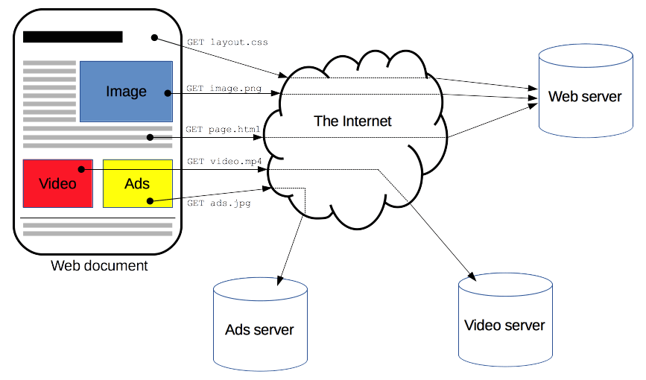
Overview on HTTP
1. Internet
1.1. Internet Protocol
1.2. IP Address
1.3. Internet Software Architecture
2. Web Technologies
2.1. Anatomy of Web
2.2. Server-side
2.3. Client-side
2.4. Anatomy of Webpage
2.4.1. HTML
2.4.2. CSS
2.4.3. JavaScript
3. Overview on HTTP
3.1. HTTPS
3.2. OSI Model
4. Information Architecture
5. Service-Oriented Architecture
6.Web Performance
6.1. How to increase Web Performance
7.Learn more
Hyper Text Transform Protocol
A protocol for fetching HTML documents
Client-server protocol
Requests are initiated from the Web browser.

Slide 24
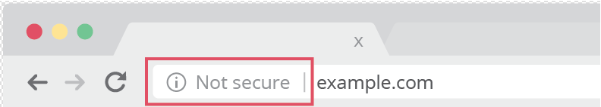
HTTPS
1. Internet
1.1. Internet Protocol
1.2. IP Address
1.3. Internet Software Architecture
2. Web Technologies
2.1. Anatomy of Web
2.2. Server-side
2.3. Client-side
2.4. Anatomy of Webpage
2.4.1. HTML
2.4.2. CSS
2.4.3. JavaScript
3. Overview on HTTP
3.1. HTTPS
3.2. OSI Model
4. Information Architecture
5. Service-Oriented Architecture
6.Web Performance
6.1. How to increase Web Performance
7.Learn more
Secure version of HTTP
Encrypted form to increase security while data transfer
Used in website that requires users to input their sensitive data.
Install Certificates on web host

Slide 25
HTTPS Methods
1. Internet
1.1. Internet Protocol
1.2. IP Address
1.3. Internet Software Architecture
2. Web Technologies
2.1. Anatomy of Web
2.2. Server-side
2.3. Client-side
2.4. Anatomy of Webpage
2.4.1. HTML
2.4.2. CSS
2.4.3. JavaScript
3. Overview on HTTP
3.1. HTTPS
3.2. OSI Model
4. Information Architecture
5. Service-Oriented Architecture
6.Web Performance
6.1. How to increase Web Performance
7.Learn more
GET
POST
UPDATE
DELETE

Slide 26
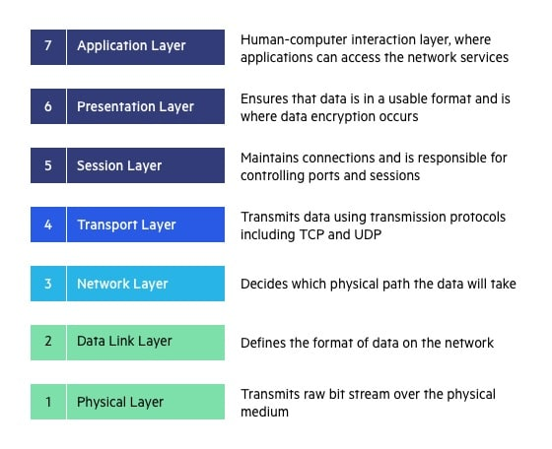
OSI Model
1. Internet
1.1. Internet Protocol
1.2. IP Address
1.3. Internet Software Architecture
2. Web Technologies
2.1. Anatomy of Web
2.2. Server-side
2.3. Client-side
2.4. Anatomy of Webpage
2.4.1. HTML
2.4.2. CSS
2.4.3. JavaScript
3. Overview on HTTP
3.1. HTTPS
3.2. OSI Model
4. Information Architecture
5. Service-Oriented Architecture
6.Web Performance
6.1. How to increase Web Performance
7.Learn more
Stands for Open System Interconnection
Comprises of seven layers that computer system use to communicate over a network.
Need to know
Layer 3
Layer 4
Layer 7

Slide 27
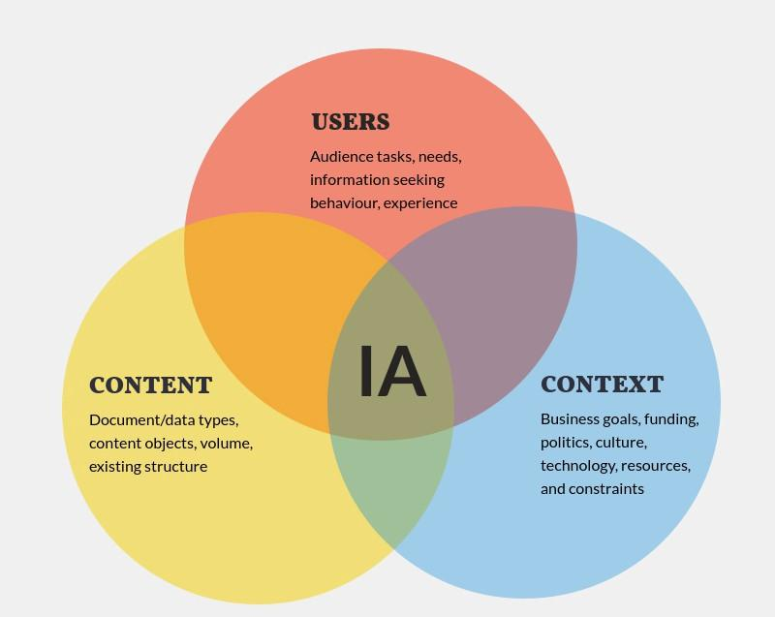
Information Architecture
1. Internet
1.1. Internet Protocol
1.2. IP Address
1.3. Internet Software Architecture
2. Web Technologies
2.1. Anatomy of Web
2.2. Server-side
2.3. Client-side
2.4. Anatomy of Webpage
2.4.1. HTML
2.4.2. CSS
2.4.3. JavaScript
3. Overview on HTTP
3.1. HTTPS
3.2. OSI Model
4. Information Architecture
5. Service-Oriented Architecture
6.Web Performance
6.1. How to increase Web Performance
7.Learn more
Organizing, structuring and labeling content
Goal of IA is to help user find information to complete tasks

Slide 28
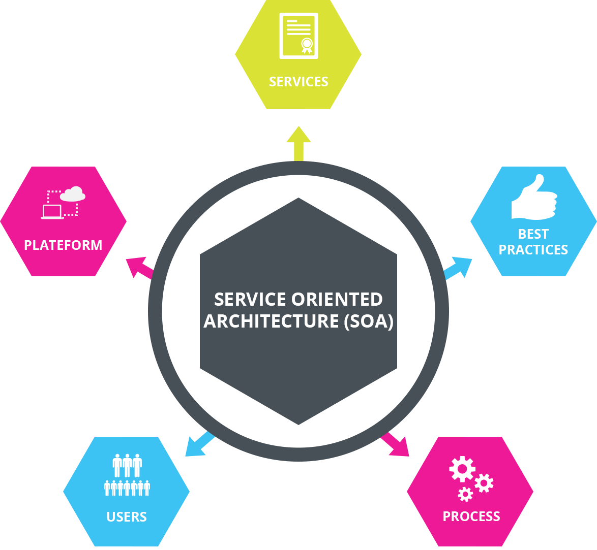
Service-oriented Architecture
1. Internet
1.1. Internet Protocol
1.2. IP Address
1.3. Internet Software Architecture
2. Web Technologies
2.1. Anatomy of Web
2.2. Server-side
2.3. Client-side
2.4. Anatomy of Webpage
2.4.1. HTML
2.4.2. CSS
2.4.3. JavaScript
3. Overview on HTTP
3.1. HTTPS
3.2. OSI Model
4. Information Architecture
5. Service-Oriented Architecture
6.Web Performance
6.1. How to increase Web Performance
7.Learn more
Software development model that allows service to communicate across different platforms to form application
Use of services available in the network
Make easier for the developer to assemble their apps

Slide 29
Service-oriented Architecture Pros
1. Internet
1.1. Internet Protocol
1.2. IP Address
1.3. Internet Software Architecture
2. Web Technologies
2.1. Anatomy of Web
2.2. Server-side
2.3. Client-side
2.4. Anatomy of Webpage
2.4.1. HTML
2.4.2. CSS
2.4.3. JavaScript
3. Overview on HTTP
3.1. HTTPS
3.2. OSI Model
4. Information Architecture
5. Service-Oriented Architecture
6.Web Performance
6.1. How to increase Web Performance
7.Learn more
Reusability
Scalability
Flexibility
Interoperability
Cost-effective
Agility
Modularization
Integration
It can be used in Banking, Ecommerce, HealthCare, Transportation,
Government Sector.

Slide 30
Service-oriented Architecture Cons
1. Internet
1.1. Internet Protocol
1.2. IP Address
1.3. Internet Software Architecture
2. Web Technologies
2.1. Anatomy of Web
2.2. Server-side
2.3. Client-side
2.4. Anatomy of Webpage
2.4.1. HTML
2.4.2. CSS
2.4.3. JavaScript
3. Overview on HTTP
3.1. HTTPS
3.2. OSI Model
4. Information Architecture
5. Service-Oriented Architecture
6.Web Performance
6.1. How to increase Web Performance
7.Learn more
Complexity
Overhead
Performance
Testing
Governance
Vendor lock-in
Security
Skillset

Slide 31

Web Performance
1. Internet
1.1. Internet Protocol
1.2. IP Address
1.3. Internet Software Architecture
2. Web Technologies
2.1. Anatomy of Web
2.2. Server-side
2.3. Client-side
2.4. Anatomy of Webpage
2.4.1. HTML
2.4.2. CSS
2.4.3. JavaScript
3. Overview on HTTP
3.1. HTTPS
3.2. OSI Model
4. Information Architecture
5. Service-Oriented Architecture
6.Web Performance
6.1. How to increase Web Performance
7.Learn more
All about making websites fast
Reducing overall load time
Making the site usable as soon as possible
Smoothness and interactivity
Perceived performance
Performance measurements

Slide 32

How to increase Web Performance
1. Internet
1.1. Internet Protocol
1.2. IP Address
1.3. Internet Software Architecture
2. Web Technologies
2.1. Anatomy of Web
2.2. Server-side
2.3. Client-side
2.4. Anatomy of Webpage
2.4.1. HTML
2.4.2. CSS
2.4.3. JavaScript
3. Overview on HTTP
3.1. HTTPS
3.2. OSI Model
4. Information Architecture
5. Service-Oriented Architecture
6.Web Performance
6.1. How to increase Web Performance
7.Learn more
Optimize images
Minify CSS and JavaScript
Implement browser caching
Reduce HTTP requests
Use asynchronous loading
Optimize server response time
29

Slide 33


Slide 34
Before you come for Lab, Research!!
1. Internet
1.1. Internet Protocol
1.2. IP Address
1.3. Internet Software Architecture
2. Web Technologies
2.1. Anatomy of Web
2.2. Server-side
2.3. Client-side
2.4. Anatomy of Webpage
2.4.1. HTML
2.4.2. CSS
2.4.3. JavaScript
3. Overview on HTTP
3.1. HTTPS
3.2. OSI Model
4. Information Architecture
5. Service-Oriented Architecture
6.Web Performance
6.1. How to increase Web Performance
7.Learn more
HTML5 Doctor
HTML5: W3C Schools
HTML5: Tutorial Points
Mdn web docs

Slide 35


